Slide 1


Does Semi-Natural Habitat Amplify Beneficial Spider Populations
in a California Organic Vineyard?
IALE 2019
Cord Phelps
Lindsey Norgrove, Ph.D
Bern University of Applied Sciences
School of Agricultural, Forest and Food Sciences

Slide 2
Introduction
Semi-natural habitats (SNH) are believed to contribute various ecosystem services in agricultural settings. Faced with an array pest management challenges, the organic wine grape industry and associated research institutions have evaluated the potential contribution of SNH to biological control strategies. However, conclusions are often contradictory and qualitative.
This study evaluates the sensitivity of beneficial spider populations to the proximity of SNH in a California Central Coast organic vineyard. The data suggests that the effect is very weak.

Slide 3
Introduction (continued)
While vineyard biodiversity accentuates arthropod predation and parasitization (Altieri 2010), both semi-natural habitats and cover crops have been studied for many years as a refuge for, and source of, insects that antagonize vineyard pests. However, the climate of the Central Coast and general scarcity of irrigation water limits the persistence and utility of cover crops as a driver of biodiversity. As a consequence, SNH pest regulation contributions are of interest.
“SNH” is characterized by reduced management activity and the presence of native vegetation (Mestre 2018) . On the Central Coast, vineyards are often surrounded by a SNH profile composed of grasslands used for grazing interspersed with oak trees (Quercus douglasii).

Slide 4
open questions
What is the contribution of SNH to vineyards in the California central coast?
Does that contribution change in time and space during the growing season?
Can dominant arthropod beneficials be easily identified and monitored?
Do answers to these questions ultimately inform vineyard block layout decisions?

Slide 5
hypotheses
(i) arthropod diversity and abundance in SNH rows is greater than those expressed by rows not supported by SNH
(ii) beneficial arthropod density should be higher at the SNH margin and decrease moving into the vineyard
(iii) beneficial arthropod maximum density diffuses into the vineyard over the growing season
(iv) vineyard beneficial arthropod density can be measured using vane traps suspended in the canopy

Slide 6
materials and methods
Study Area: Our 2018 study was hosted by Ampelos Vineyards in the Sta. Rita Hills American Viticultural Area of Santa Barbara County, California. This AVA is characterized by heavy marine fog in the mornings and clearing with a steady wind in the afternoon.
We selected a control transect bordered by a plowed field and a SNH transect with several large native oak trees at its base. These two transects were chosen due to their relative proximity, and their orientation to the prevailing wind.
Arthropods were collected with blue vane traps suspended in the canopy.

Slide 7
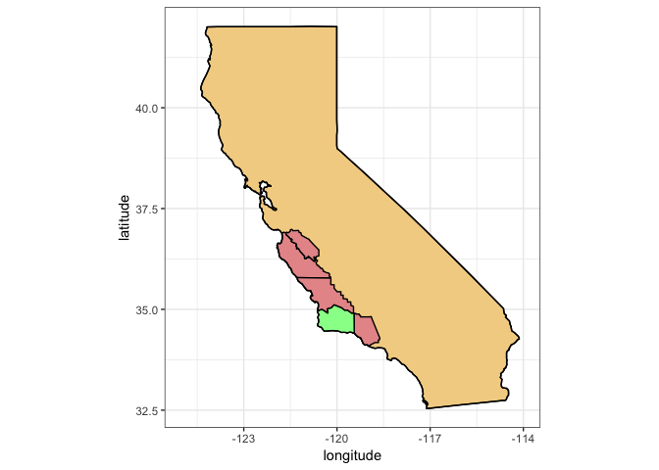
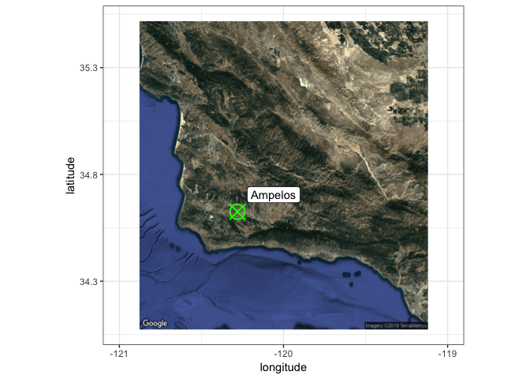
Study Area

Slide 8
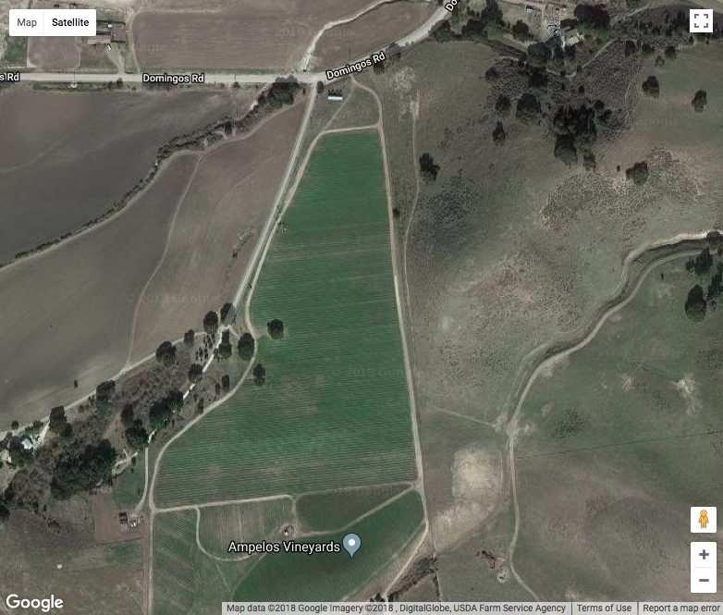
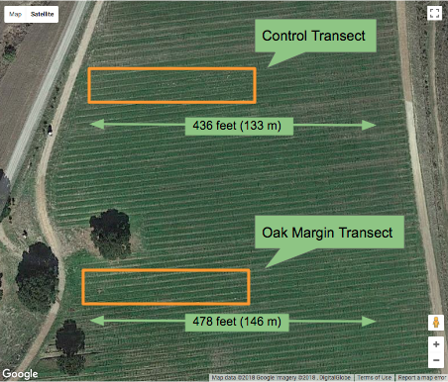
Study Area (continued)

Slide 9
Arthropod Sampling
Two transects, each populated by 30 blue vane traps, were sampled twice per day, usually three days per week, for 12 weeks during the growing season. 3,720 trap observations were made with 4,583 animals recorded and released. We found the numerically dominant arthropod predator to be crab spiders, Thomisidae.
The transect trap layout was designed to increase observational sensitivity closer to the edge of the vineyard row. The 30 traps were arranged in 3 rows of 10. Rows were separated by an un-sampled row.

Slide 10
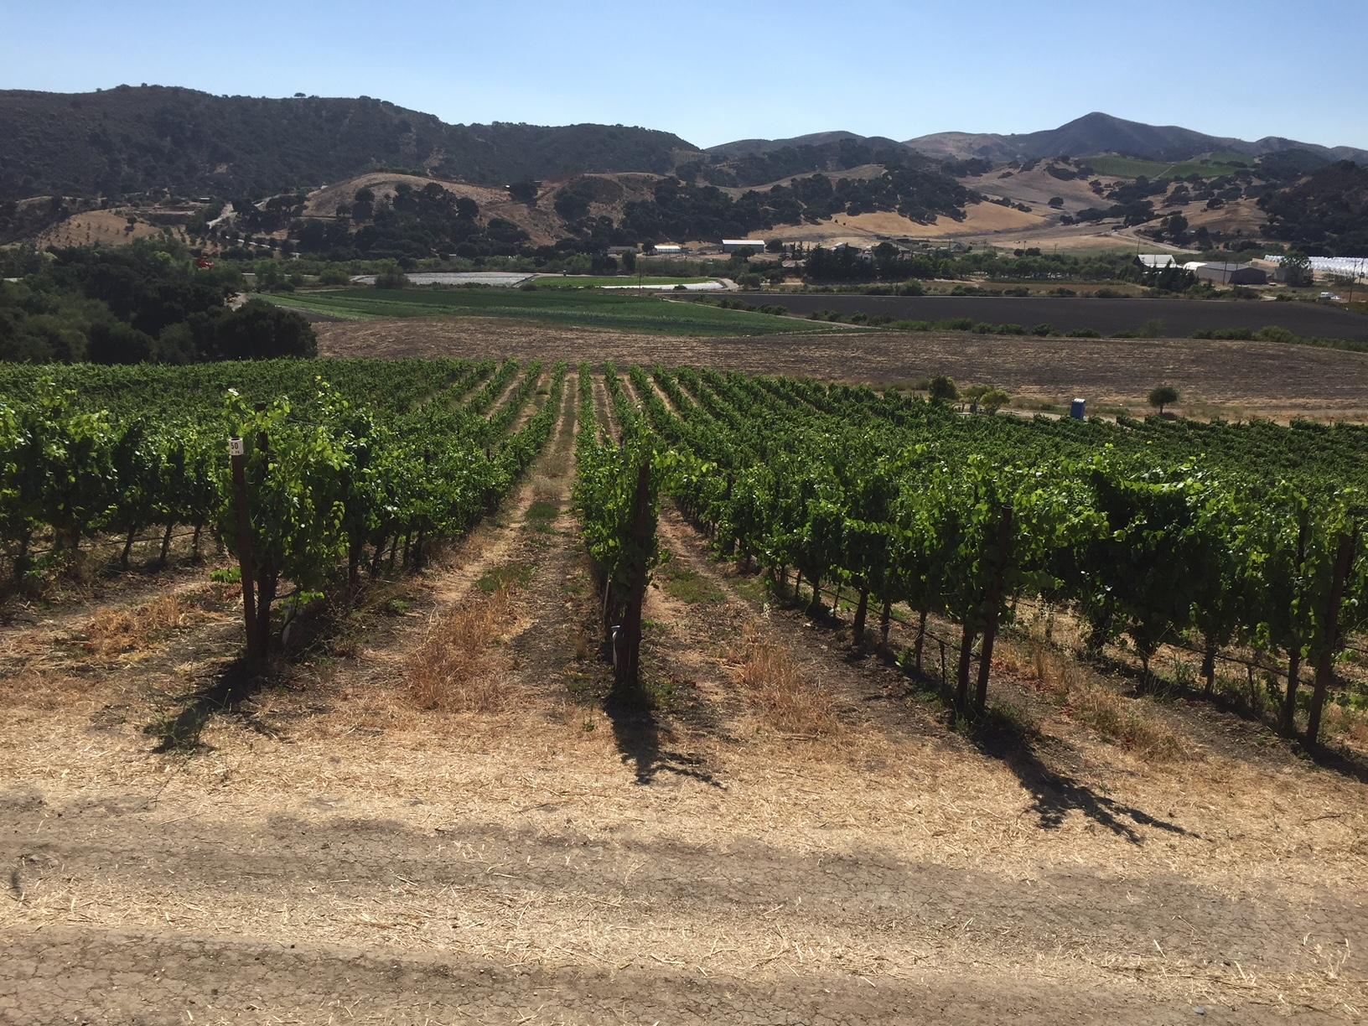
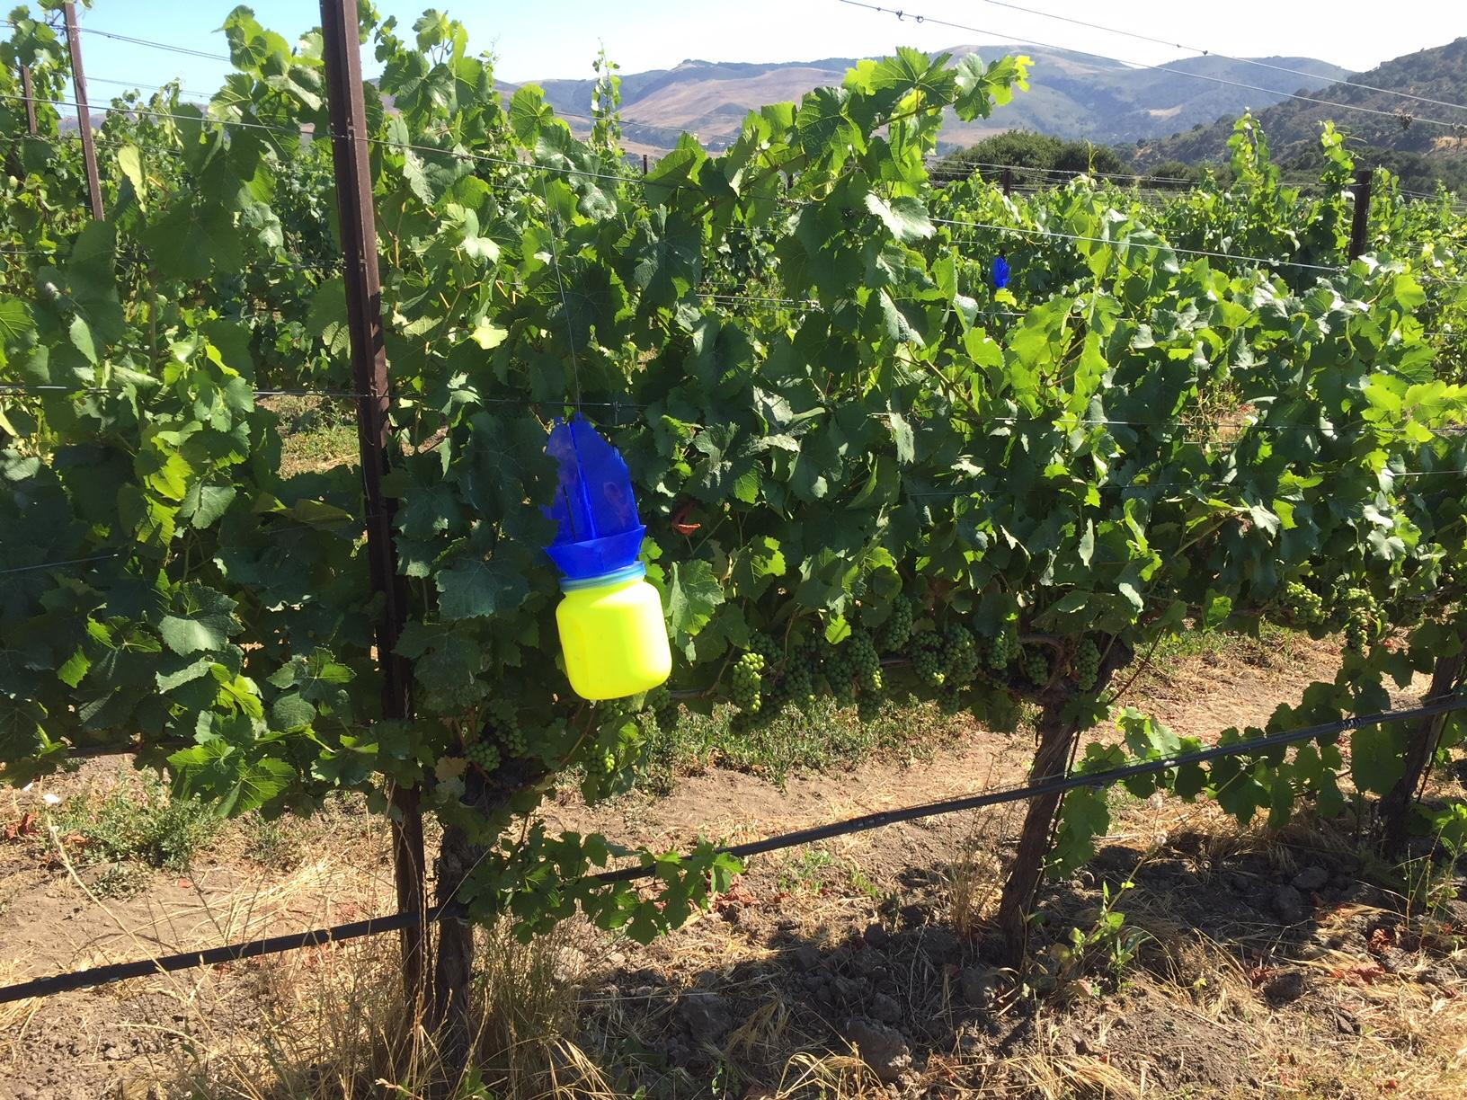
Arthropod Sampling (continued)

Slide 11
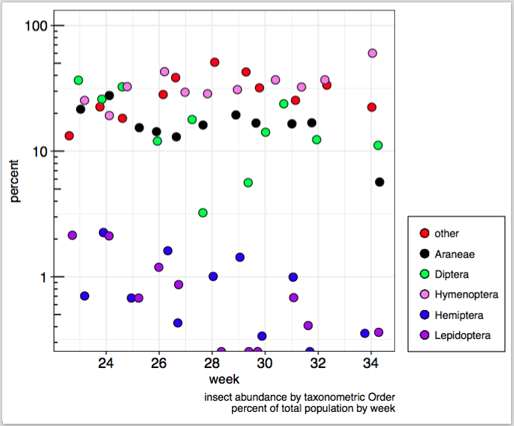
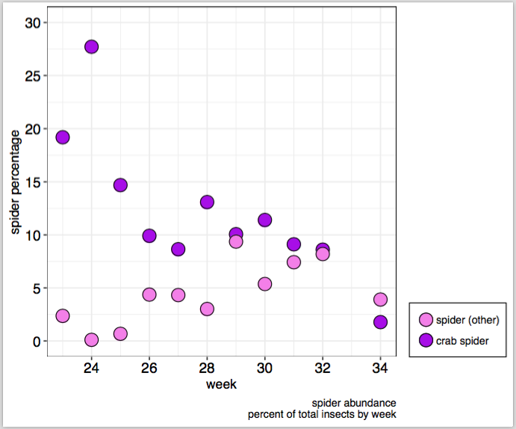
results : arthropod diversity and abundance

Slide 12
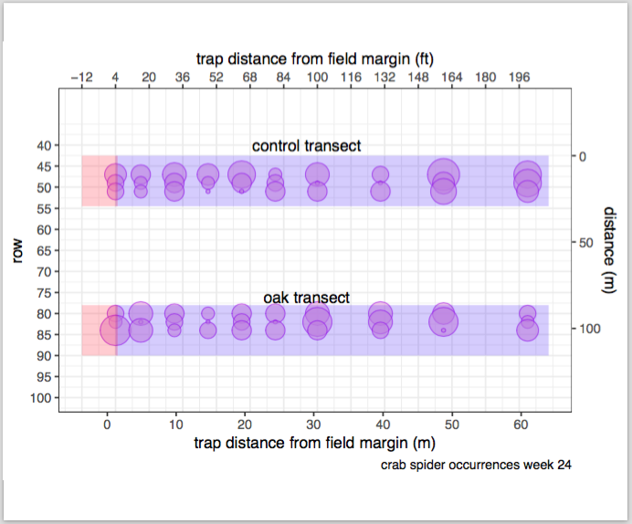
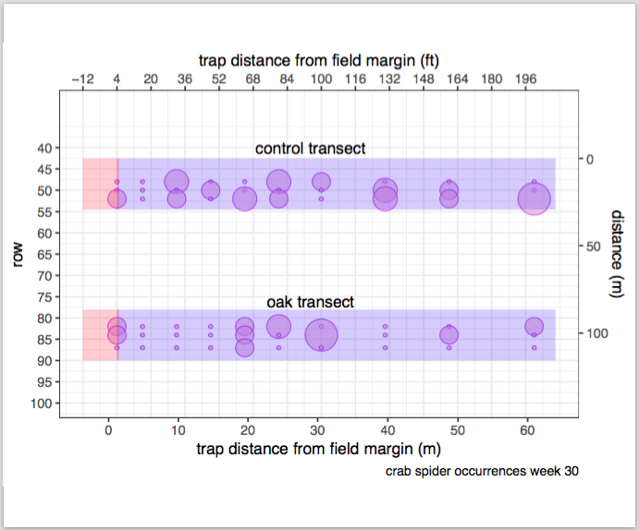
results : beneficial spider spatial density
Different density patterns develop as the weeks progress suggesting that ‘clusters’ exist

Slide 13
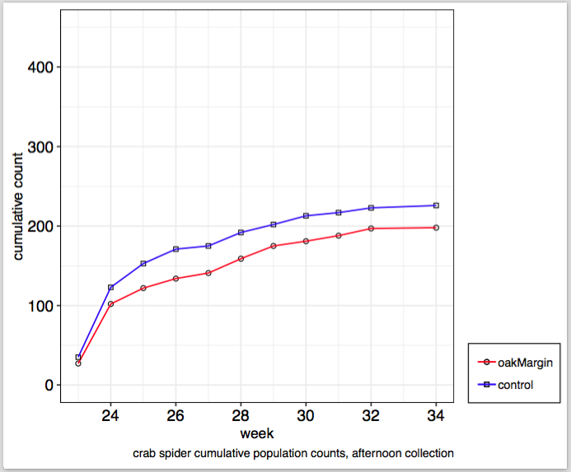
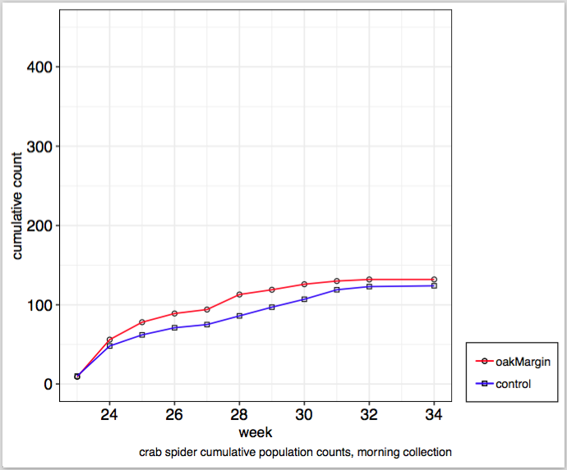
results : assessing spider populations
pm control spider population was more abundant

Slide 14
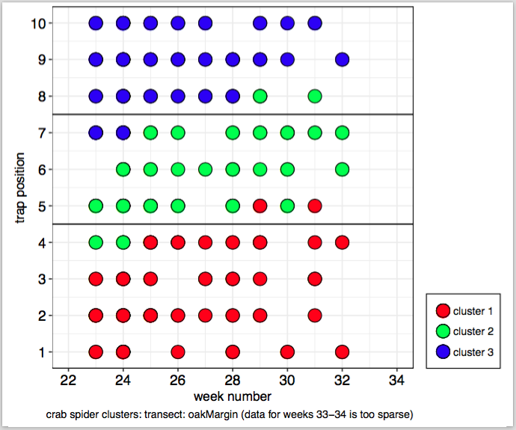
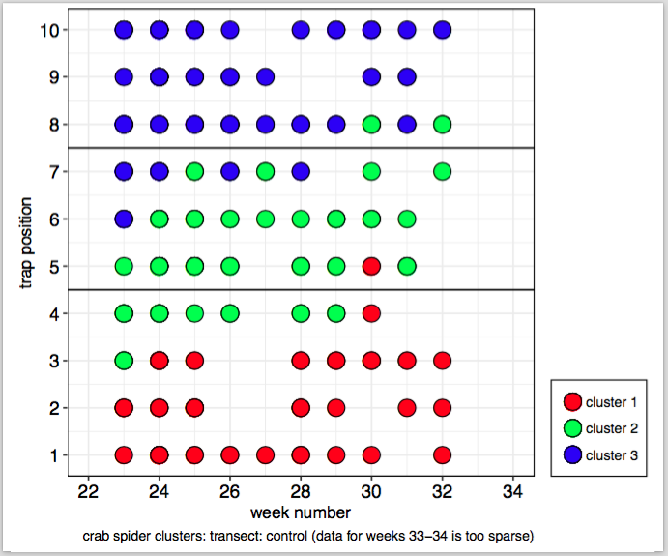
results : assessing seasonal spider populations, spatial density
Data is sparse

Slide 15
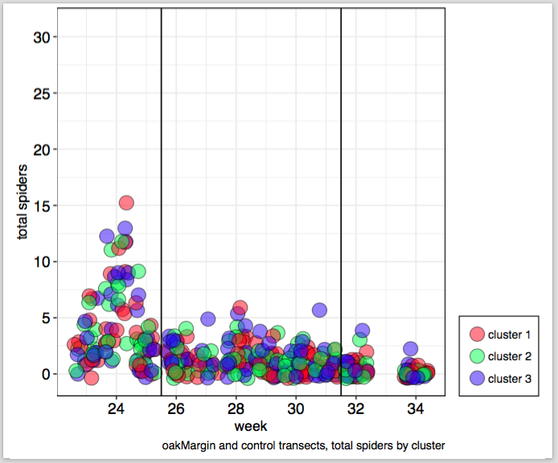
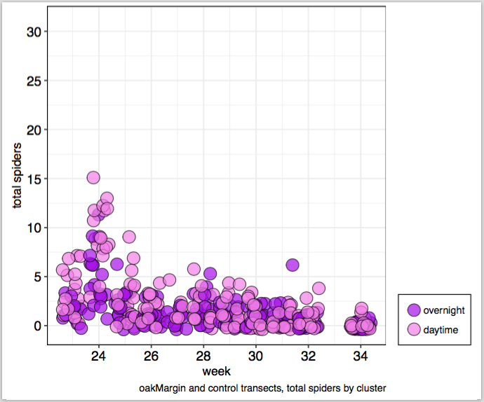
results : assessing seasonal spider populations
Three arbitrary timeframes

Slide 16
Research hypothesis translated for a ‘GLM’ model
- the number of trapped spiders increases with log(population)
- the number of trapped spiders increases with natural habitat support. Ecological justification: from the research, beneficial insect population increases with SNH.
- the impact of population on trapped spiders increases with natural habitat support (ie, the association (or, parameter “interaction”) of trapped spiders and log population depends on the presence of natural habitat.) Ecological justification: more prey, more spider movement, more encounters with the trap.
Poisson regression: a GLM modeling an outcome without a known maximum (a binomial distribution with a low probability of an event and a large amount of trials; the mean and the variance are almost identical)

Slide 17
‘GLM’ model (continued)
- seasonal priors assumed based on 3 different normal distributions
- Poisson regression: a GLM modeling an outcome without a known maximum (a binomial distribution with a low probability of an event and a large amount of trials; the mean and the variance are almost identical); R package bmrs::brm()
- model based on the Oceanic Tool Complexity Model, Population size predicts technological complexity in Oceania (Kline 2010). Tools developed is a function of population and cultural exposure rate.

Slide 18
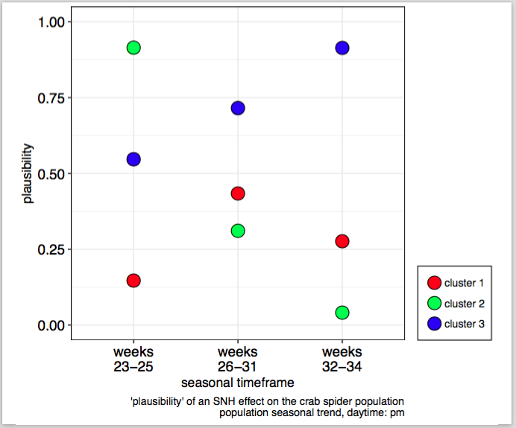
results : SNH proximity has an effect?
likely
un-likely
(poisson regression of count data where the absolute population density is unknown)

Slide 19
hypotheses → conclusions
i) arthropod diversity and abundance in SNH rows is greater than the diversity expressed by rows not supported by SNH : for spiders, yes, but only at mid-season
(ii) beneficial arthropod density should be higher at the SNH margin and decrease moving into the vineyard : for spiders, no, this was not observed
(iii) beneficial arthropod maximum density diffuses into the vineyard over the growing season : for spiders, apparently not, but more analysis needed
(iv) vineyard beneficial arthropod density can be measured using vane traps suspended in the canopy : for spiders, yes, but probably not for hymenoptera (parasitoid and predaceous wasps)

Slide 20
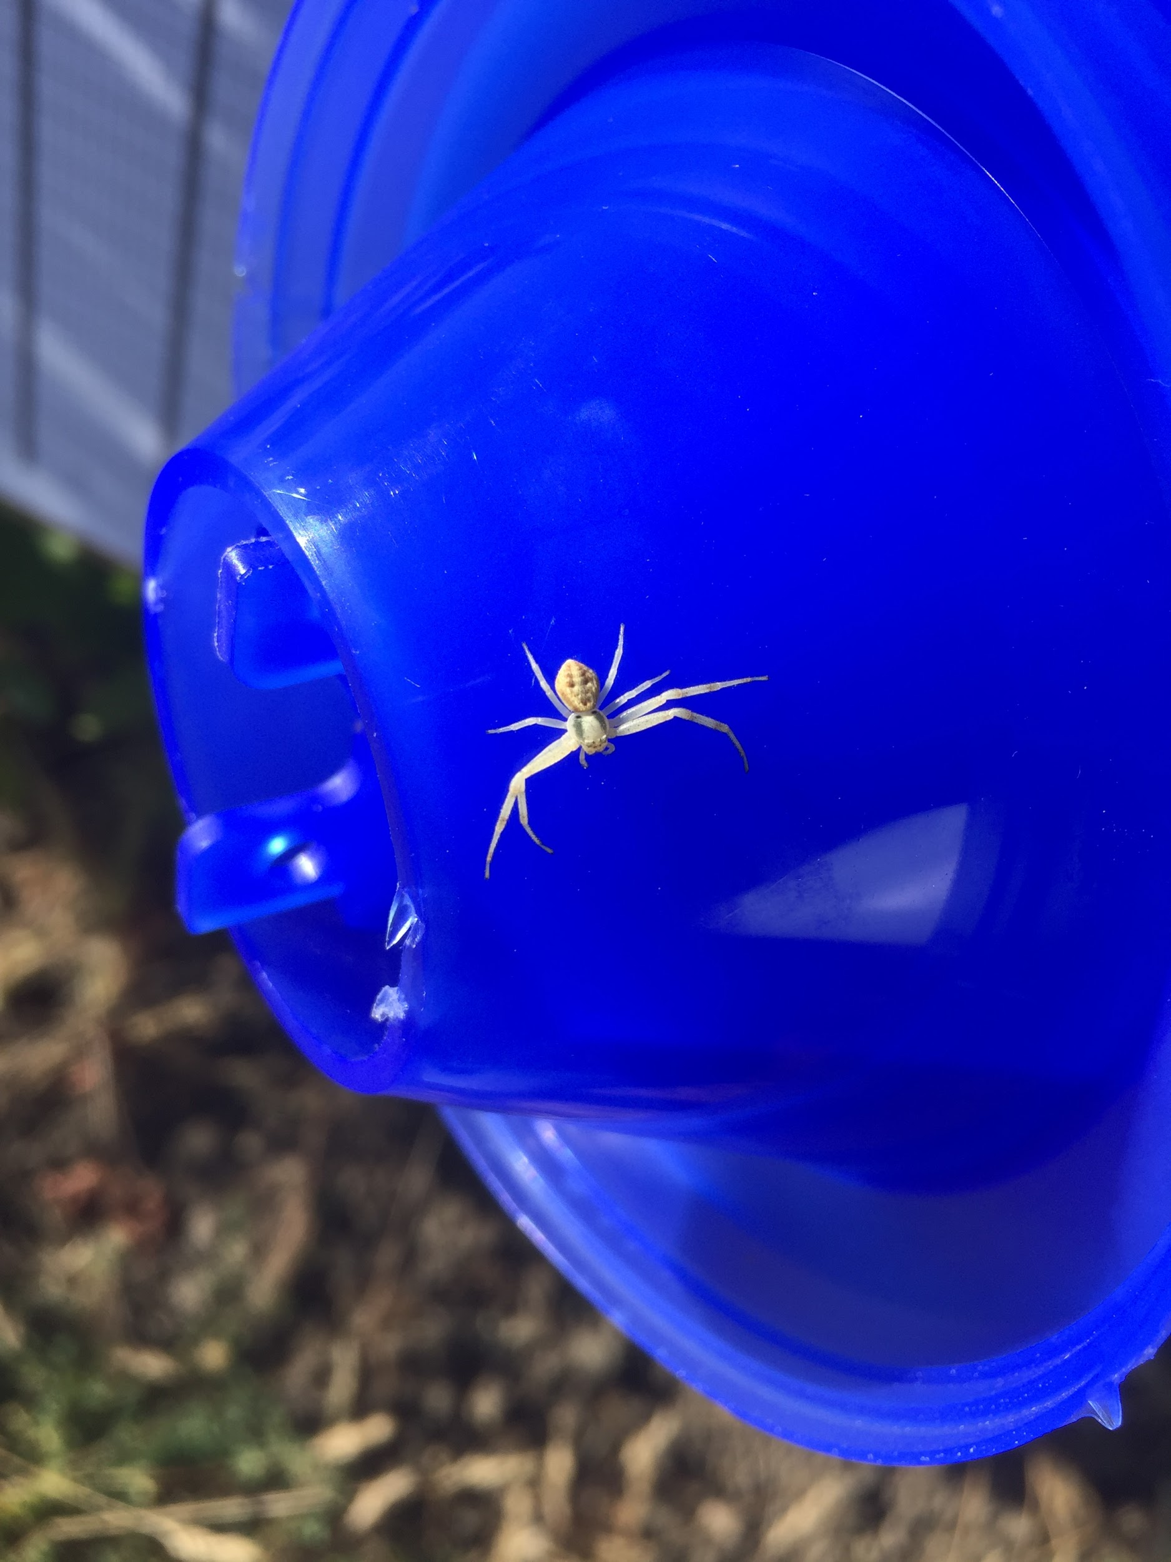
Thank you!

Slide 21
acknowledgements
Peter Work, Ampelos Vineyards
Anna Howell, UCANR Entomologist
Patrik Kehrli, Agroscope

